Slide 1





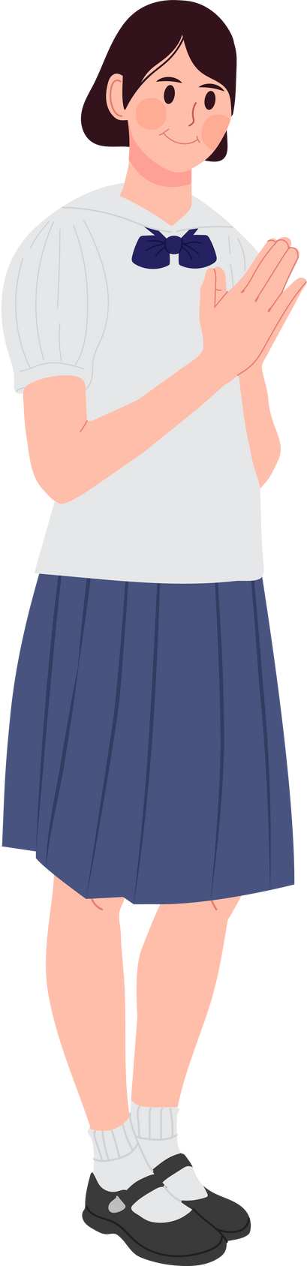
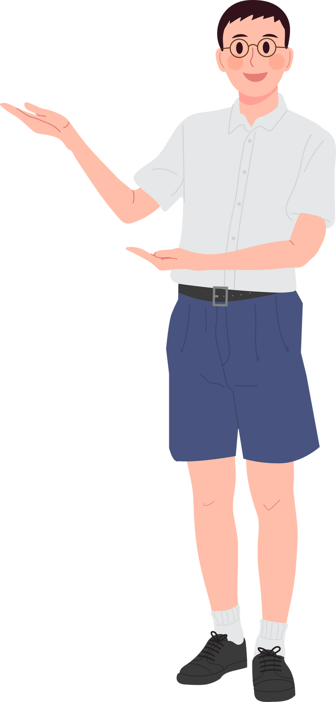
First Day Orientation
Classroom Rules
Rosa Maria Aguado National High School
www.reallygreatsite.com

Slide 2
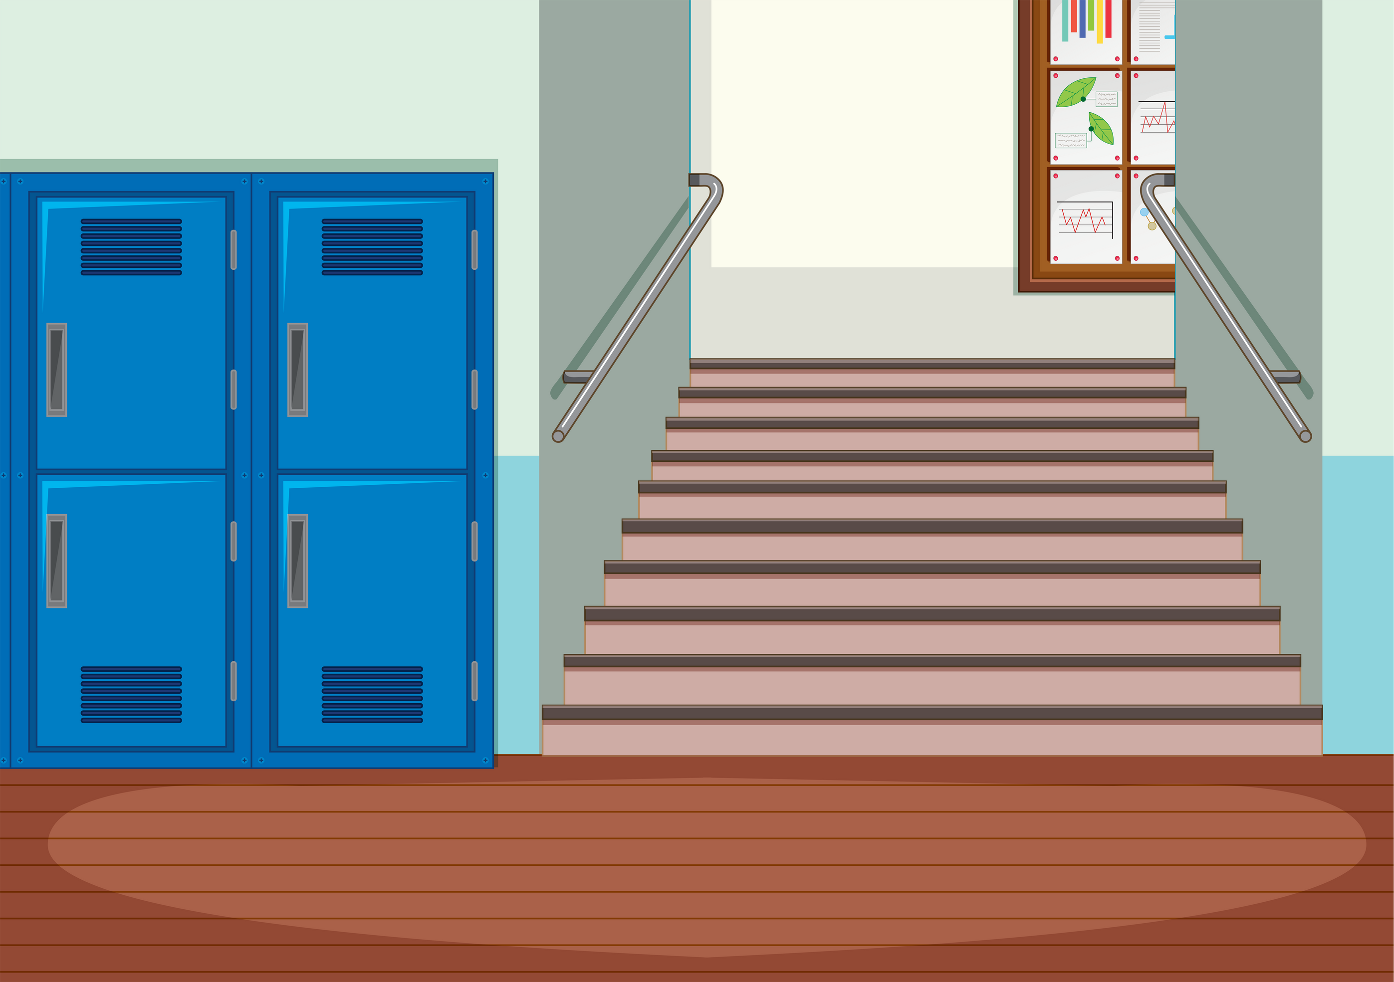

Be respectful
Treat everyone with kindness and consideration, just like you want to be treated. This includes teachers, classmates, and anyone else who enters our classroom.
Rosa Maria Aguado National High School
www.reallygreatsite.com

Slide 3

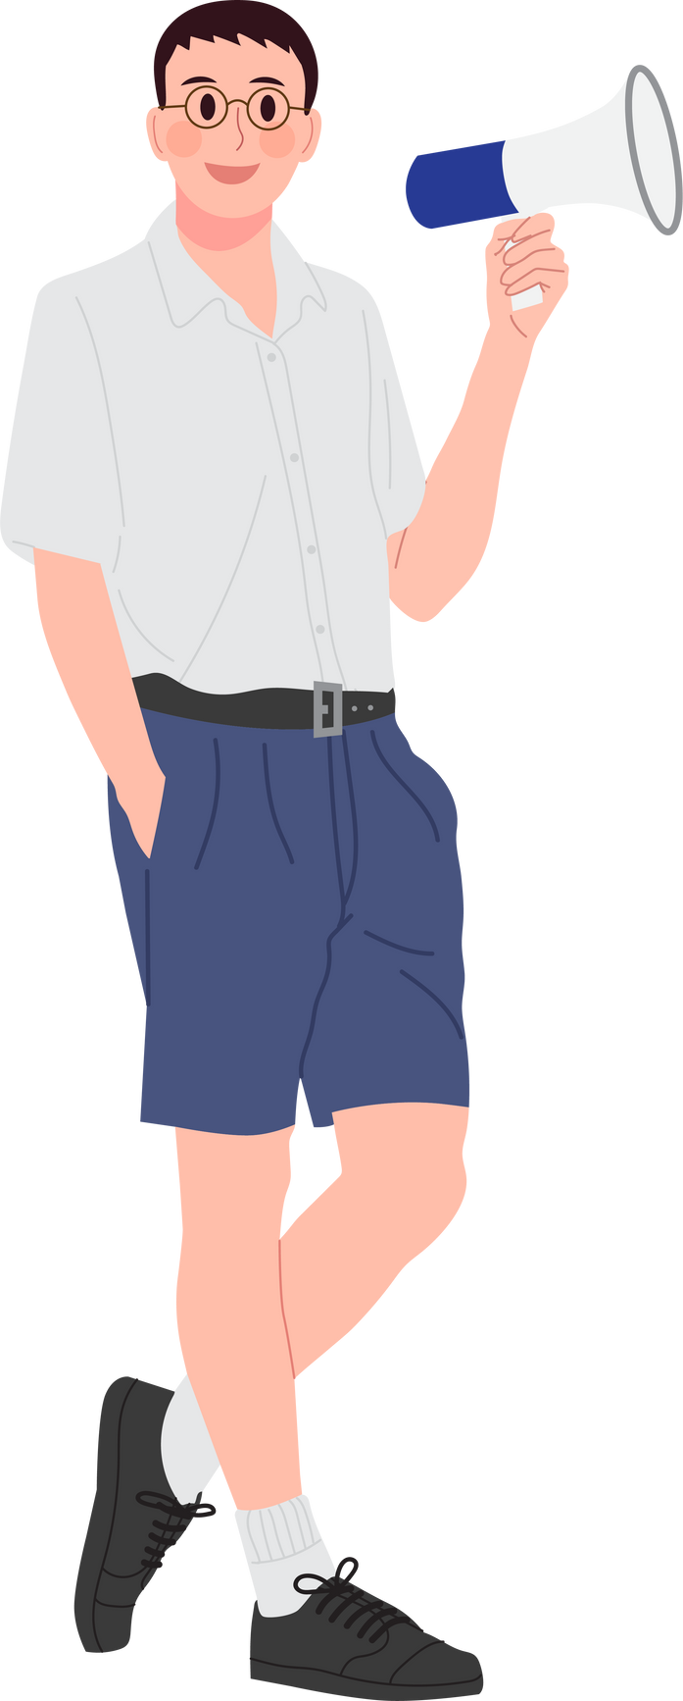

Listen actively
Pay attention to the speaker, whether it's the teacher, a classmate, or someone presenting. Avoid distractions and try to understand what's being said.
Rosa Maria Aguado National High School
www.reallygreatsite.com

Slide 4
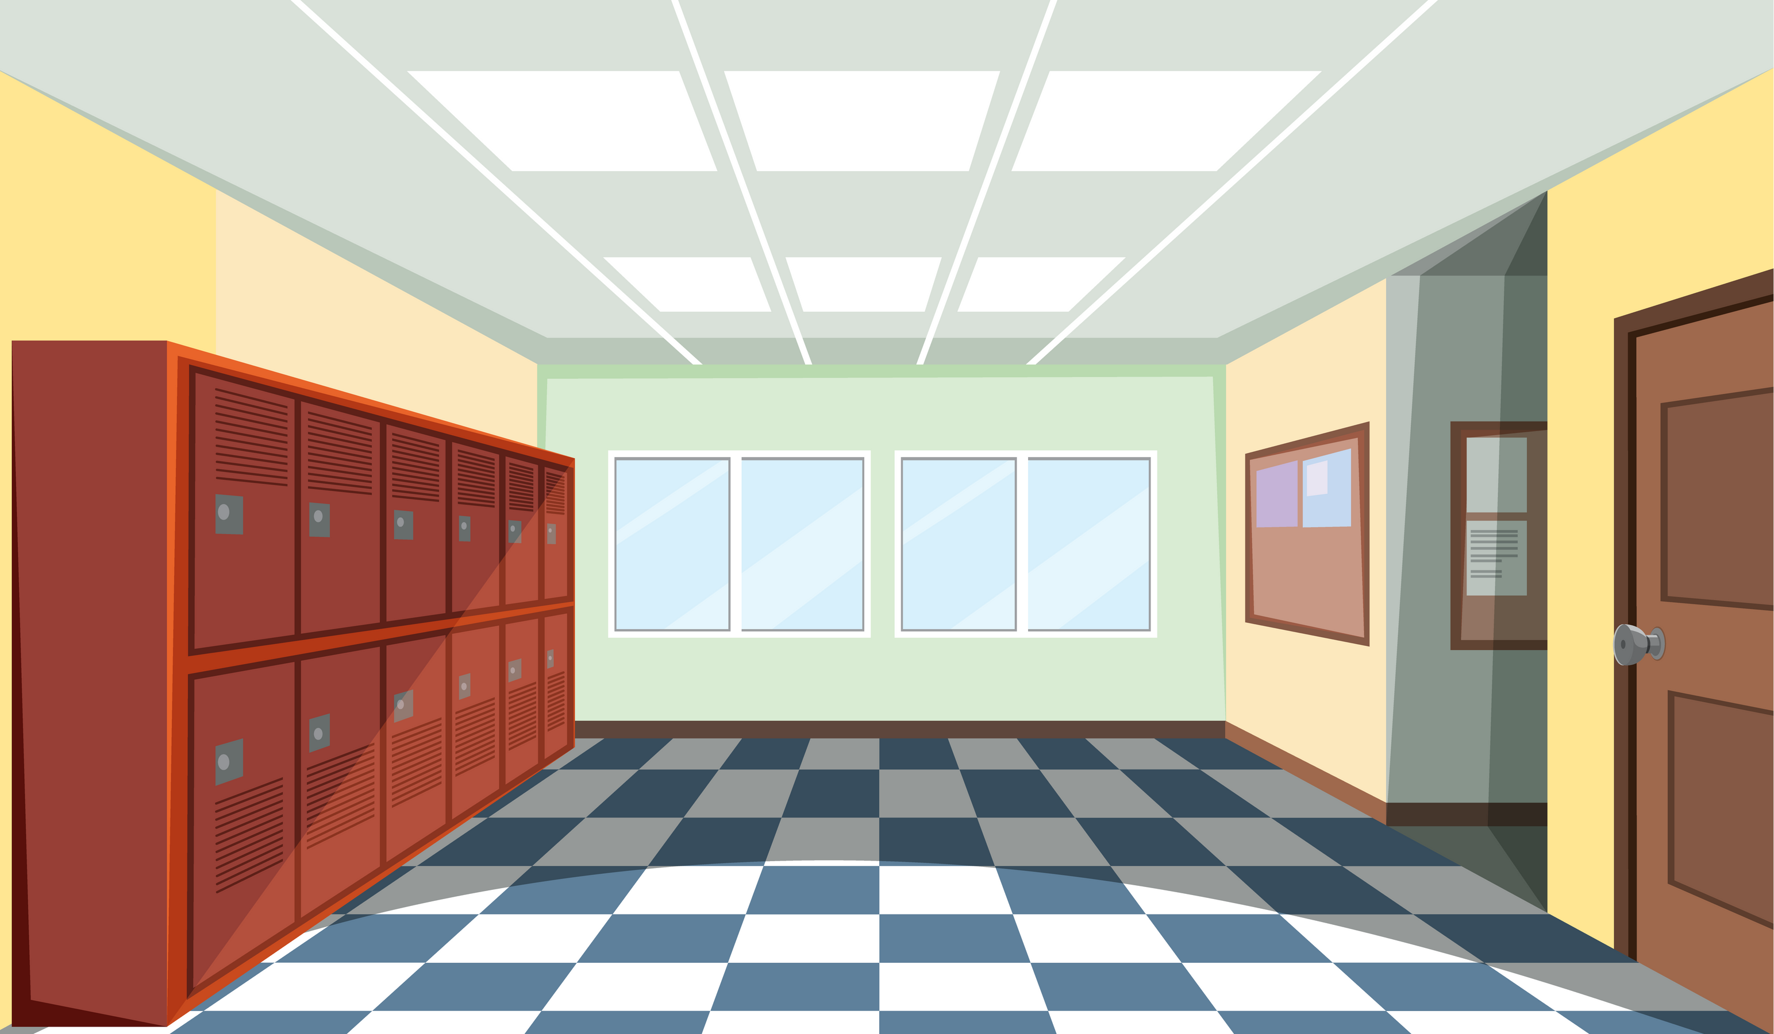
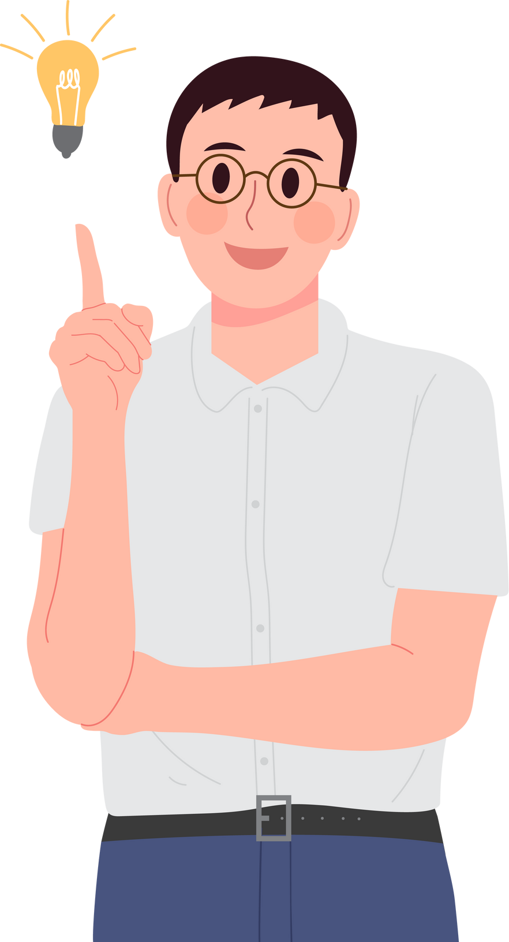

Raise hands
If you have a question or something to contribute, raise your hand and wait for your turn to speak. Interrupting is not polite and hinders others' learning.
Rosa Maria Aguado National High School
www.reallygreatsite.com

Slide 5
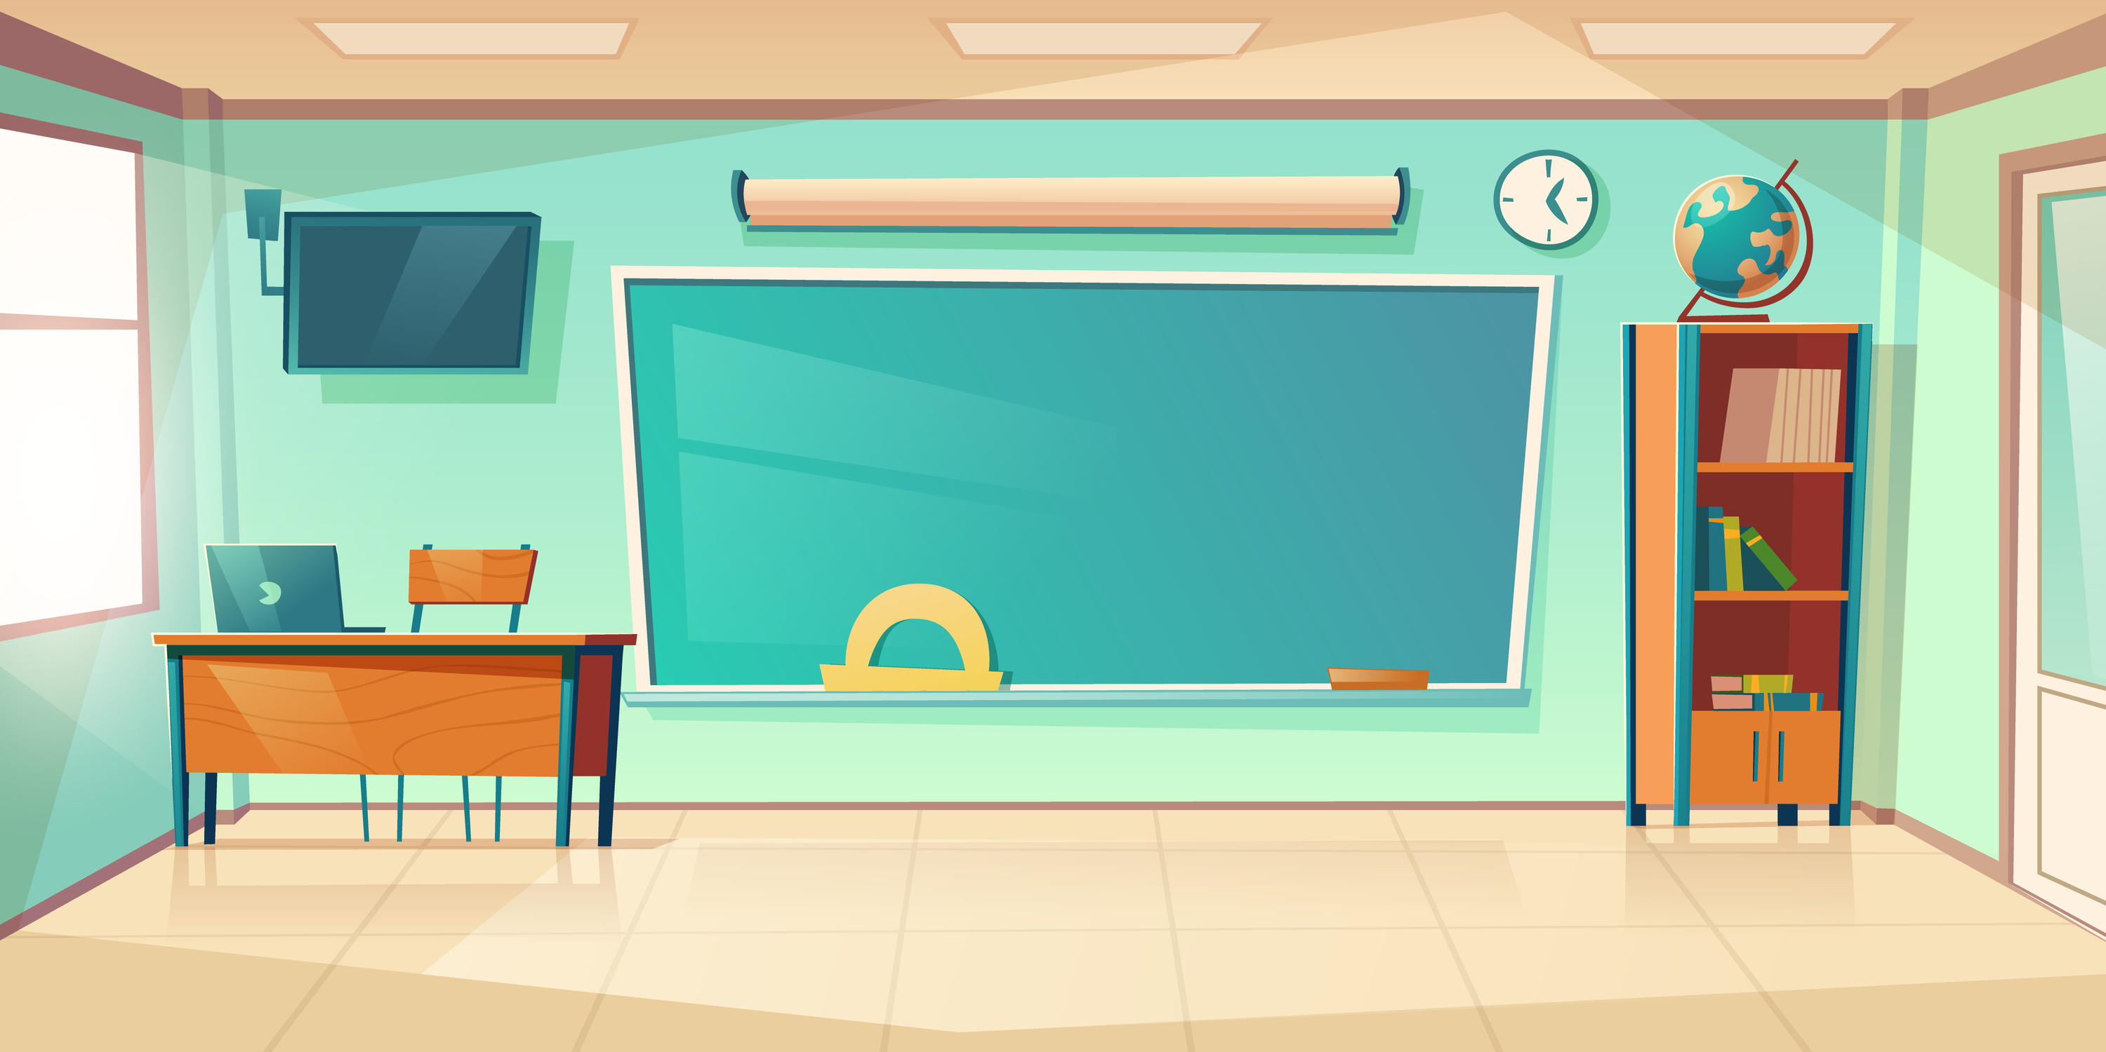


Stay focused
Avoid distractions like phones, games, or talking off-topic during class time. Focus on the lesson and make the most of your learning opportunity.
Rosa Maria Aguado National High School
www.reallygreatsite.com

Slide 6
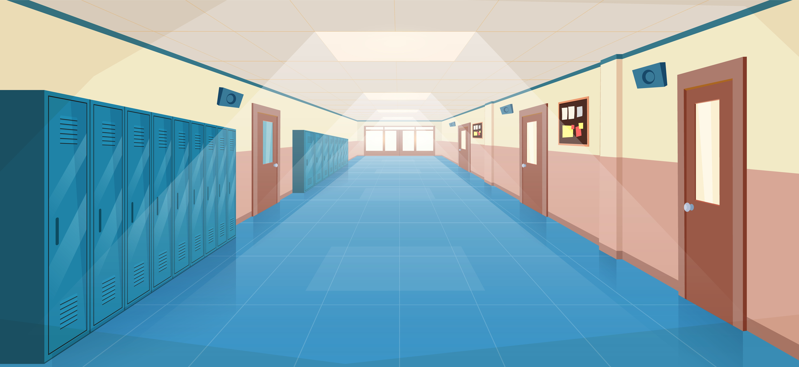


Come prepared
Come to class with all the necessary materials and be ready to learn. This shows respect for yourself and your classmates.
Rosa Maria Aguado National High School
www.reallygreatsite.com

Slide 7

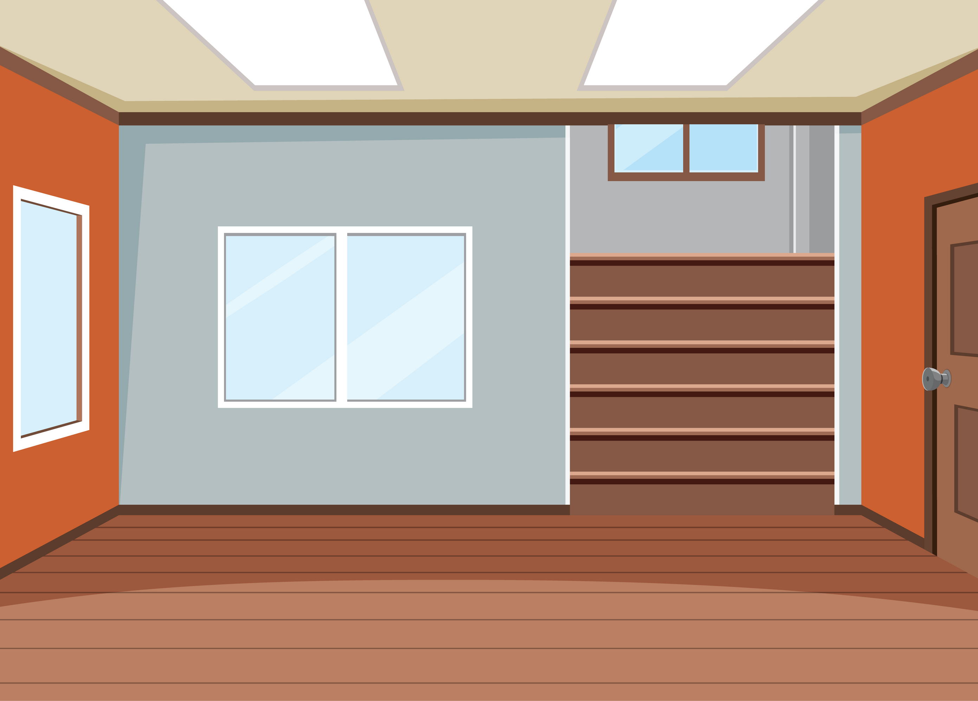
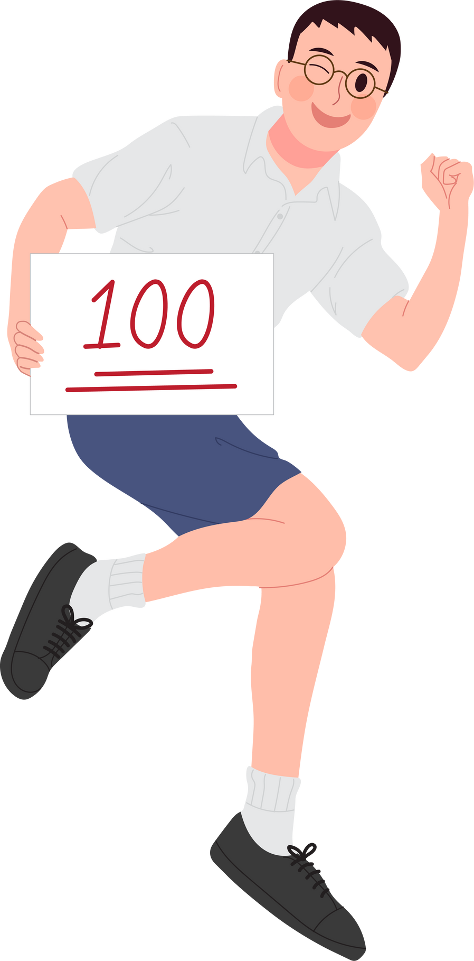
Be cooperative
Be willing to work with others in groups or projects. Share ideas, listen to others, and contribute your fair share.
Rosa Maria Aguado National High School
www.reallygreatsite.com

Slide 8
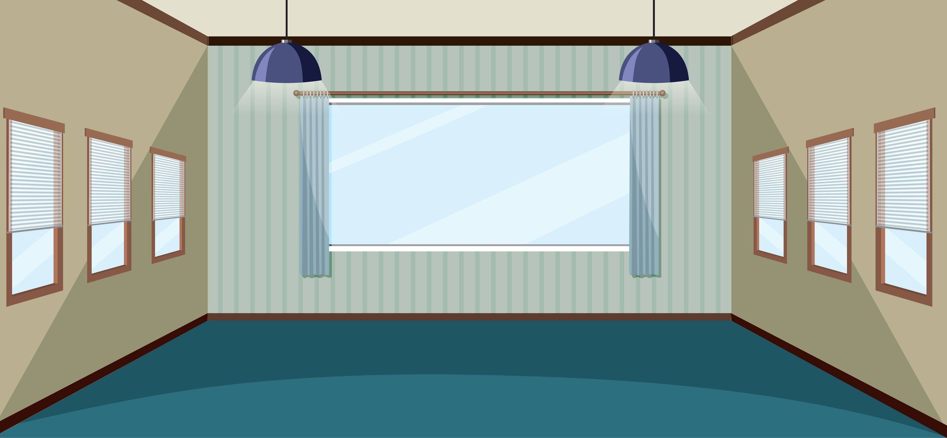
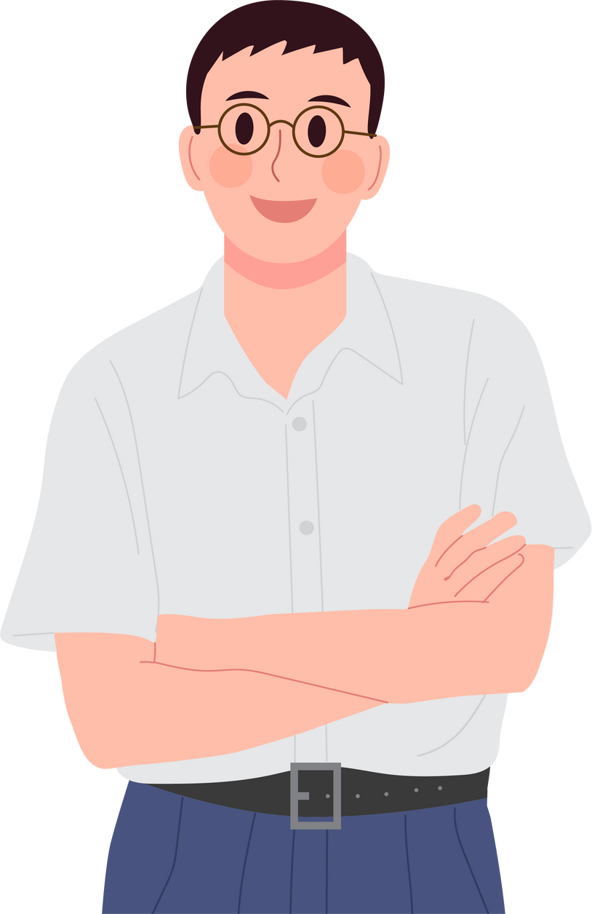
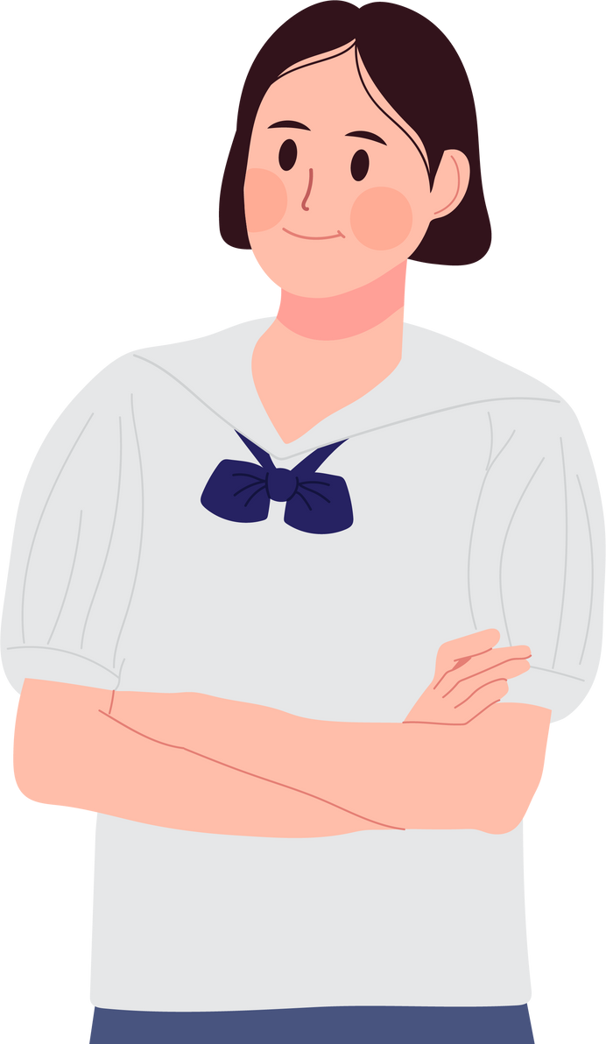
Be responsible
Own your actions and choices. If you make a mistake, apologize and try to do better next time. Being responsible builds character.
Rosa Maria Aguado National High School
www.reallygreatsite.com

Slide 9

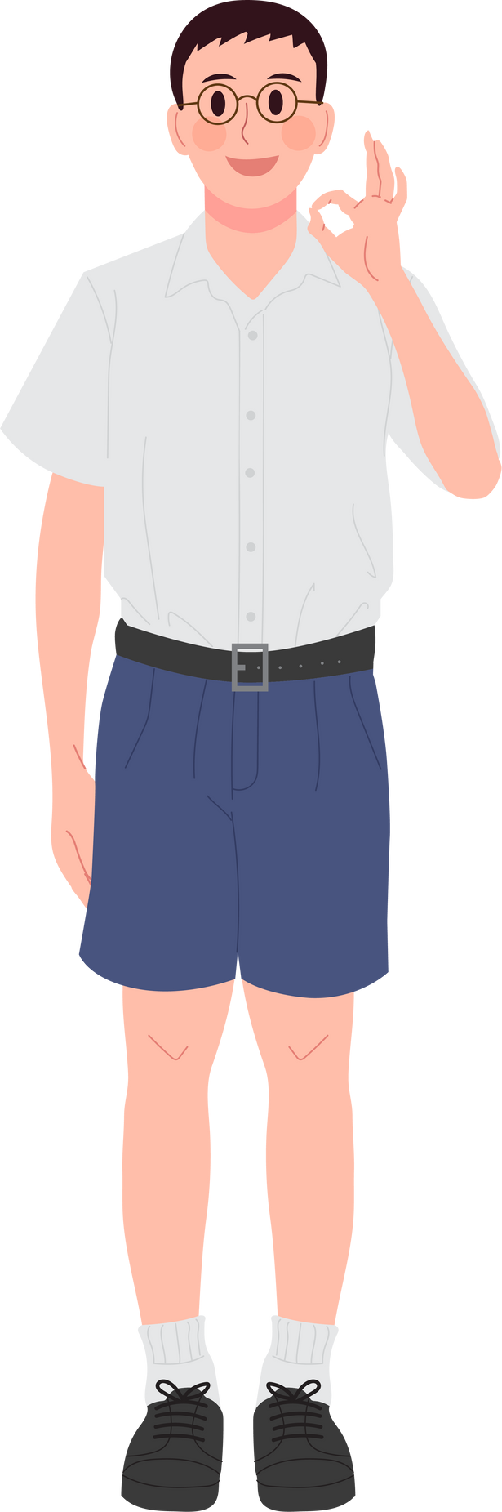
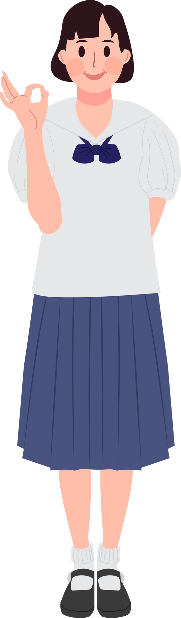
Positive attitude
Come to class with a positive mindset and willingness to learn. Your attitude can affect your learning and the learning of others.
Rosa Maria Aguado National High School
www.reallygreatsite.com

Slide 10
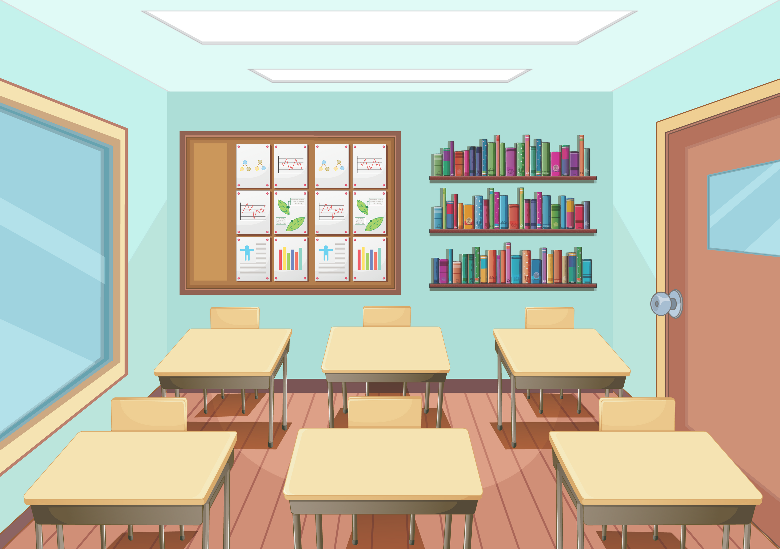
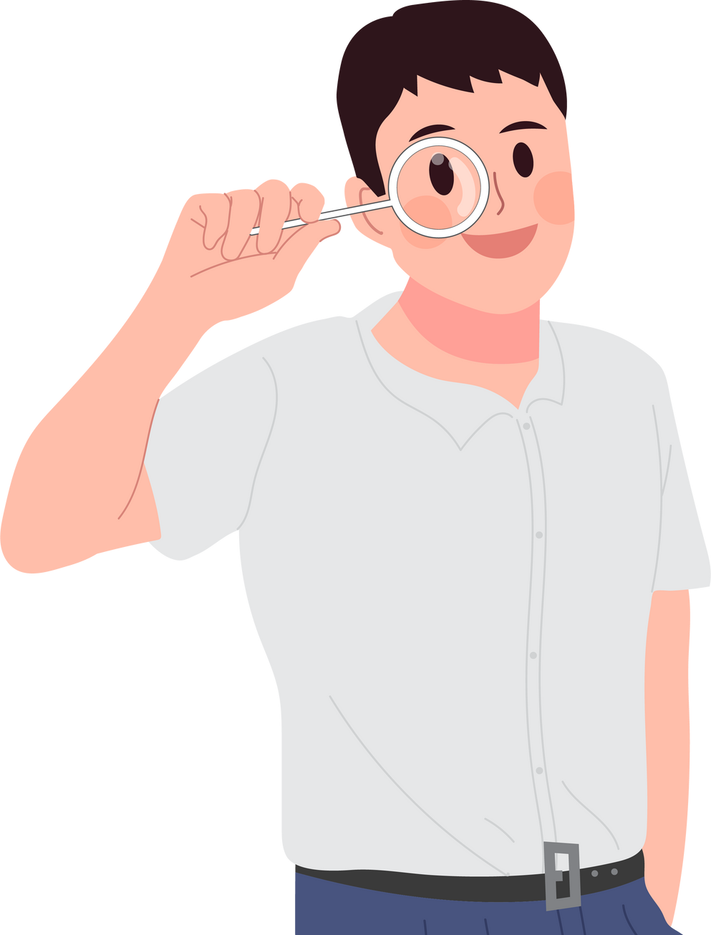

Clean and tidy
Keep the classroom clean and tidy. Don't write on walls, desks, or anywhere else you're not supposed to. Leave the classroom in better condition than you found it.
Rosa Maria Aguado National High School
www.reallygreatsite.com

Slide 11
Let’s have a great year!
Rosa Maria Aguado National High School
www.reallygreatsite.com

